Slide 1
Stern data bootcamp Session 10
2022-04-13

Slide 2
Example 1: marketing messaging
The biotech startup where I work full-time is raising a Series A round
A big part of this effort is crafting a pitch deck
The pitch deck needs to contain messaging that is unique and differentiated from other companies VCs will be looking at
We can look at competitor websites to find this messaging, but this is a manual and time-consuming process, and messaging changes frequently – multiple times a year
Ideally we would run this process automatically, and every few months we could push a button to get a report on the state of current messaging in our field
What are people saying about themselves?
What messages are most compelling?
What messages are overused?

Slide 3

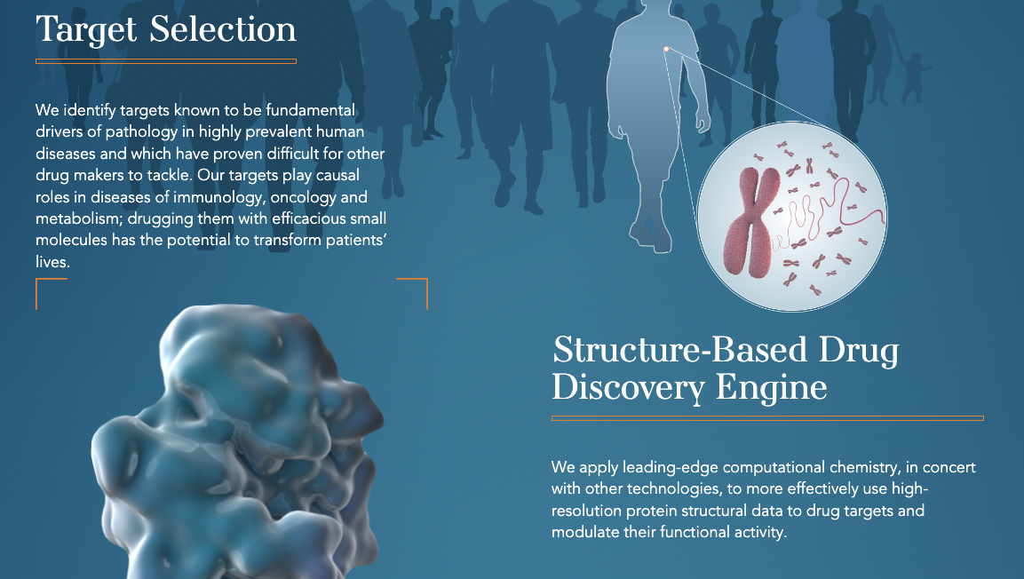
Interesting

Slide 4
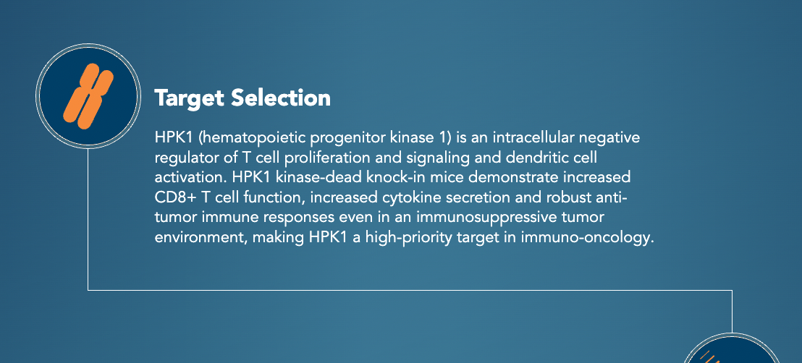

Not interesting

Slide 5
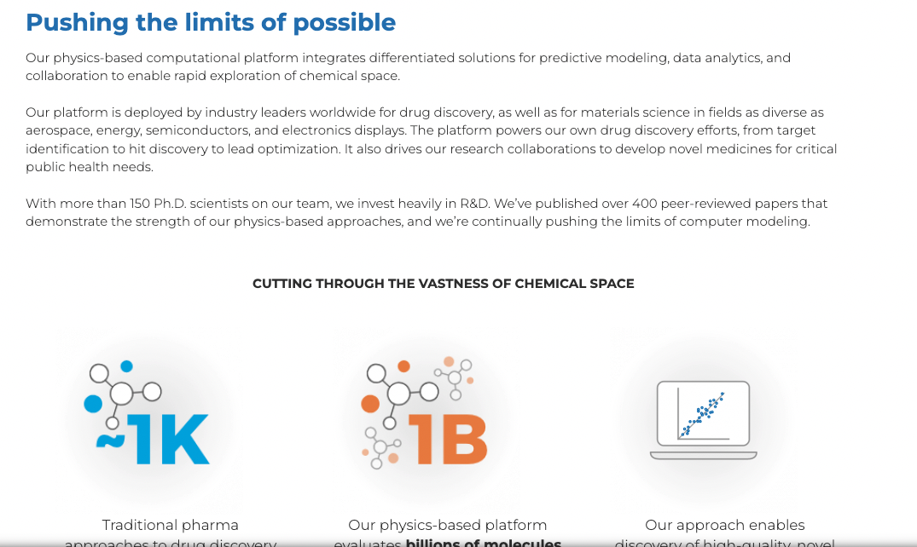
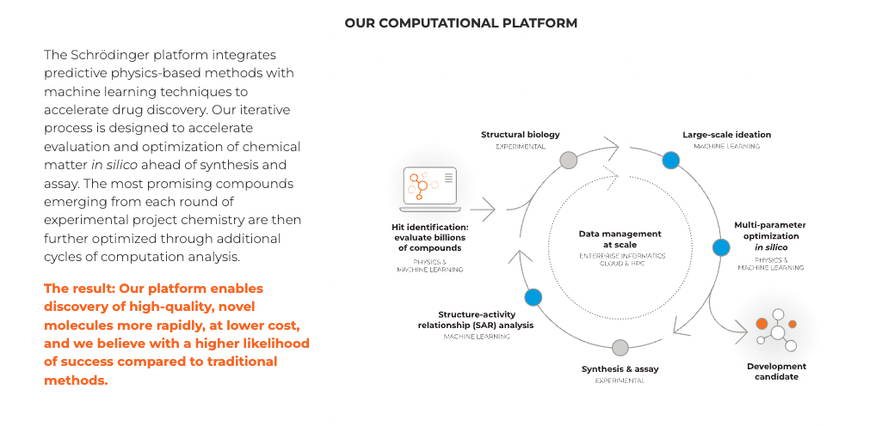
Interesting

Slide 6
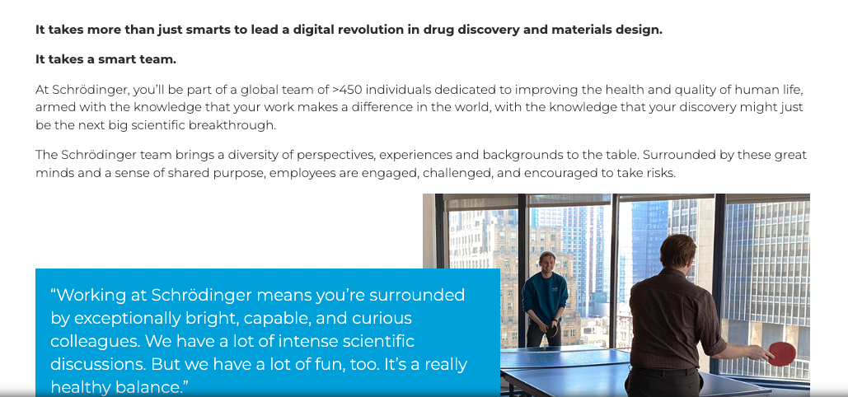
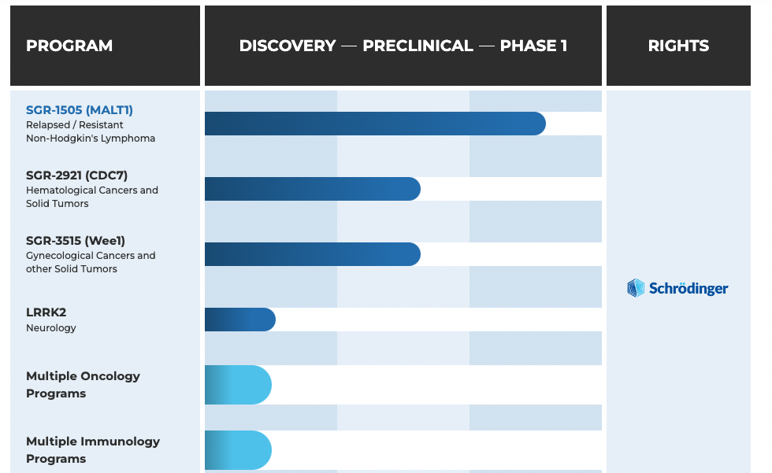
Not interesting

Slide 7





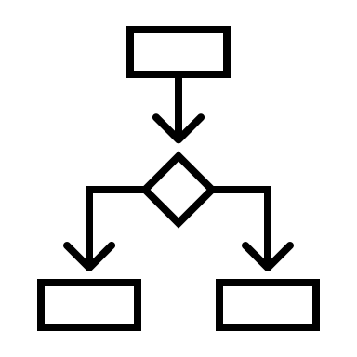
Goal: design a web scraper that produces a report on the current state of marketing messaging
Step 1: scrape text from dozens of websites
You know how to do this
Step 2: classify the data
Annoying but you only have to do it once
Step 3: train a model on the classified data
You know how to do this too
We will learn more techniques today
Step 4: use the trained model on new site data

Slide 8
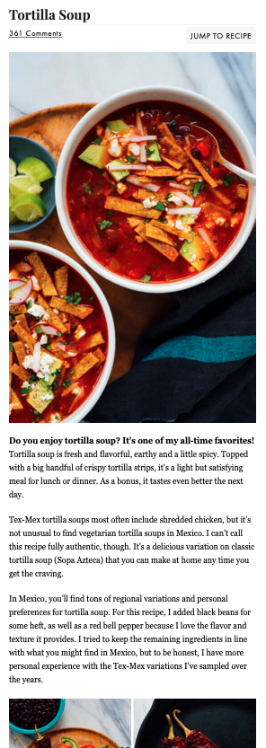
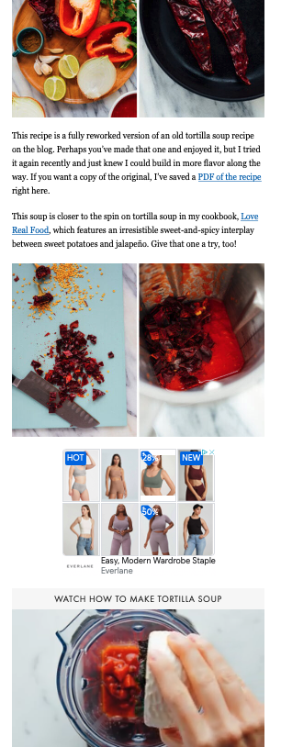
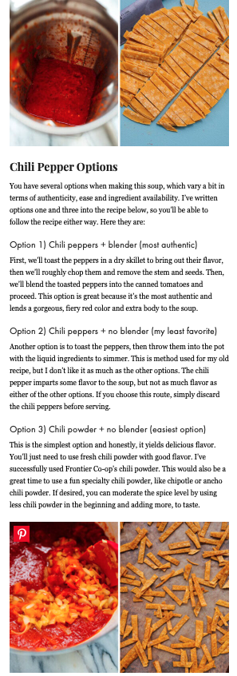
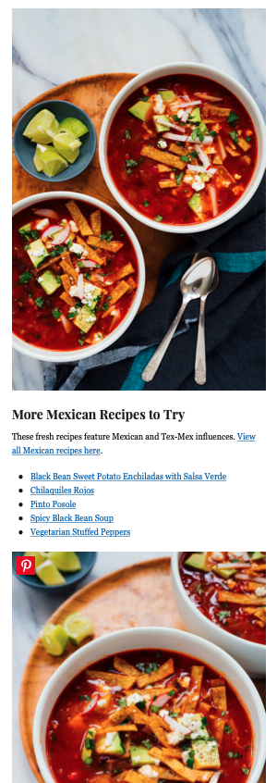
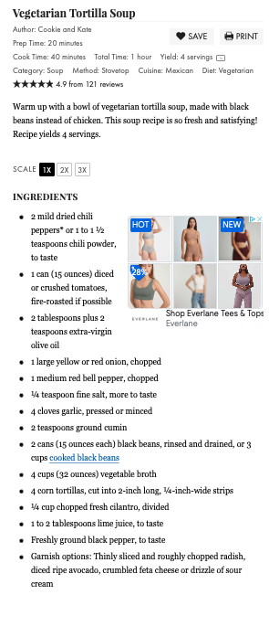
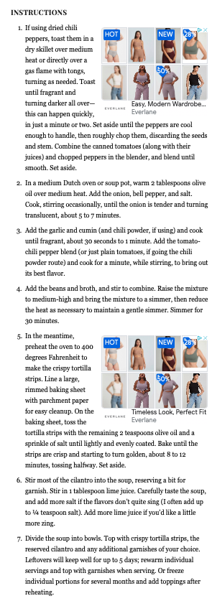
Example 2: anyone else find this annoying?
Scroll angrily past this
Actual recipe

Slide 9

ML project lifecycle
Scoping
Data
Modeling
Deployment
Define project
Define and establish baseline
Label and organize data
Select and train model
Perform error analysis
Deploy in production
Monitor and maintain system
Current state of web recipes: unstructured data
Goal: structure thousands of recipes
Metrics: accuracy of classification of text to ingredients

Slide 10
ML project lifecycle
Scoping
Data
Modeling
Deployment
Define project
Define and establish baseline
Label and organize data
Select and train model
Perform error analysis
Deploy in production
Monitor and maintain system
Inputs vary in specific choices of language – e.g., all these are the same:
“2tb unsalted butter”
“2 tablespoons butter, unsalted”
“Two tblsp. unsalted butter”
“2-3 tbsp butter (unsalted if possible)”
“2 tbl margarine or butter (use unsalted if you go with the butter)”
Even with varying inputs, outputs must be structured, requiring the definition of a schema:
Amount
Float
Measure
Categorical:
Cup
Oz
Tablespoon
…
Ingredient
Categorical:
Water
Salt
Sugar
Tamarind
Egg
…

Slide 11
ML project lifecycle
Scoping
Data
Modeling
Deployment
Define project
Define and establish baseline
Label and organize data
Select and train model
Perform error analysis
Deploy in production
Monitor and maintain system
Step 1: label the data
Manual process
Step 2: augment the data
With some labeled examples, more can be programmatically generated
Step 3: organize the data
4 primitives:
Recipe
Step
Ingredient
Material
“2 tb. Butter, the unsalted kind”
“2 tsp unsalted butter”
{“recipe”: “chocolate cake”}
“4 oz unsalted butter”
{“step”: “melt the chocolate and butter”}
{
”amount”: 2,
“measure”: “tablespoon”,
“ingredient_id”: 322
}
“1 1/3 cup unsalted butter”
{“material”: [“2 tbsp unsalted butter”,”4 oz dark chocolate”]}
“unsalted butter to taste”
{“step”: “add the flour and sugar”}
“a pat of unsalted butter”
…

Slide 12
ML project lifecycle
Scoping
Data
Modeling
Deployment
Define project
Define and establish baseline
Label and organize data
Select and train model
Perform error analysis
Deploy in production
Monitor and maintain system
Step 1: define hyperparameters
Train / test split
OOV tokens
Max string length
Training epochs
…
Step 2: embed strings
Tokenize
Project tokens into embedding space
Step 3: train model
Bidirectional LSTM

Slide 13
ML project lifecycle
Scoping
Data
Modeling
Deployment
Define project
Define and establish baseline
Label and organize data
Select and train model
Perform error analysis
Deploy in production
Monitor and maintain system
Manually view mappings
Correct labels
Apply new rows to training set
Gather more data where patterns of incorrect labels are evident
Input | Prediction | Outcome
2 tbsp unsalted butter | Unsalted butter (ingredient ID 322) | Correct
3tb butter, not salted | Salted butter (ingredient ID 425) | Incorrect
1lb butter, the unsalted kind | Unsalted butter (ingredient ID 322) | Correct
… | … | …

Slide 14
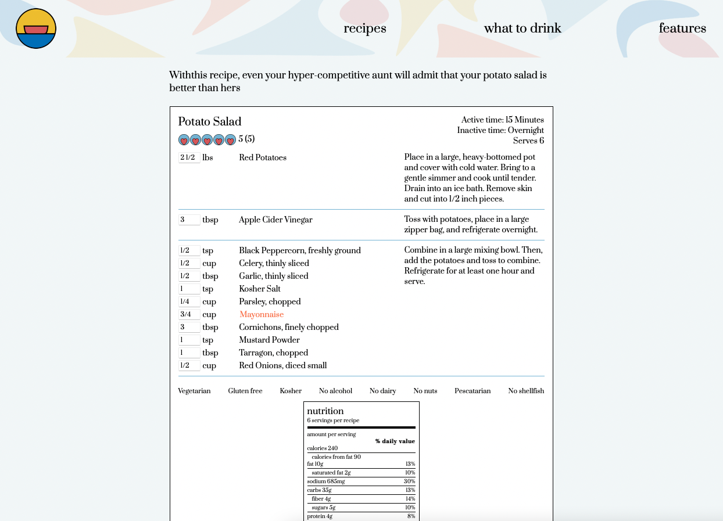
ML project lifecycle
Scoping
Data
Modeling
Deployment
Define project
Define and establish baseline
Label and organize data
Select and train model
Perform error analysis
Deploy in production
Monitor and maintain system

Slide 15
ML project lifecycle
Scoping
Data
Modeling
Deployment
Define project
Define and establish baseline
Label and organize data
Select and train model
Perform error analysis
Deploy in production
Monitor and maintain system

Slide 16
Final project parameters
Tier 1: max 70% credit
Tier 2: max 95% credit
Tier 3: full credit possible
Do all of the following:
Perform data cleaning
Perform exploratory analysis
Display visualizations of the data
Prepare the data for modeling – (e.g., all columns are numeric, null values are handled, etc)
Do any one of the following:
Train a linear model
Linear regression
Ridge / lasso regression
Decision trees
etc
Train a classification model
Logistic regression
K nearest neighbors
Decision trees
etc
Do any one of the following:
Forecast a future period of data (if your data is a time series)
Train a neural network for regression or classification
Include an advanced, interactive visualization (discuss with me if you’re unsure what you’re considering is interesting enough)

